Slide 1
Literature Review

Slide 2
Dealing with Data Quality Issues
Common techniques with data quality issues (e.g. missing tuples/values) include imputation and removal but how does this affect demographic fairness of the dataset?
Error detection and data repair
Main challenges/disparities
holistic data quality
effectiveness of data cleaning methods
ML model performance

Slide 3
Hypothesis
Automated data cleaning techniques
have significant impact on model accuracy
more likely to worsen fairness than to improve it
Two Main Concerns
Does poor data quality track disadvantaged groups?
Does the data cleaning process of these disadvantaged data points impact fairness of the resulting ML models?
Essentially, are we aware of the potential impact of any data that is cleaned (i.e. removed or imputed)?

Slide 4
Methodology
5 well-known datasets commonly used in research on responsible ML and data management
Built over 26,000 ML models to evaluate the effects on fairness and accuracy with no synthetic noise and just the raw data
Error detection strategies
Missing values: NULL and NaN values
Outliers identification with standard deviation, interquartile range, and isolation forest
Label errors: any tuples that are labeled as error with cleanlab library and logistic regression as base classifier
Cleanlab identifies error labels by estimating the joint distribution between given and unknown labels

Slide 5
Methodology Cont.
Automated repair methods
Missing values: numerical values are filled with column mean or mode, categorical values are filled with column mode or a constant “dummy” value
Outliers: replaced with column mean or mode
Label errors: Flipping the labels of flagged tuples

Slide 6
Research Question 1 (RQ1)
Does the incidence of data errors track demographic group membership in ML fairness datasets?

Slide 7
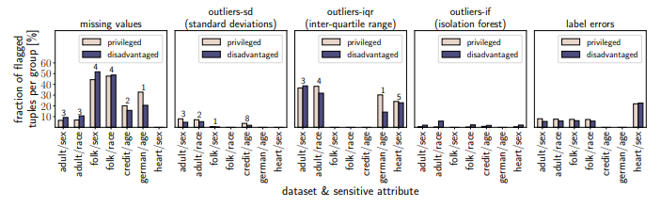
RQ1 Preparation
G - squared significance test with threshold of p=0.05
Graphs are distinguished by dataset, sensitive attribute, error type, and detection strategy
Y-axis represents the fraction of the tuples that are flagged as erroneous

Slide 8
RQ1 Results and Discussion
Mixed results in three types of errors
In heart dataset, privileged group has slightly higher FP rate (57.7% to 52.2%) and disadvantaged group has slightly higher FN rate (42% to 47.8%)
Potentially problematic since FN can exacerbate disadvantage and FP can amplify advantage
Not enough evidence to suggest poor quality data tracks disadvantaged groups

Slide 9
Research Question 2 (RQ2)
Do common automated data cleaning techniques impact the fairness of ML models trained on the cleaned datasets?

Slide 10
RQ2 setup
Goal: quantify the downstream impact automated data repairs on the fairness and accuracy ofML models.
Models:
Logistic Regression
K Nearest Neighbors
Xgboost decision Trees
Methodology:
Predictive Parity
Equal Opportunity

Slide 11
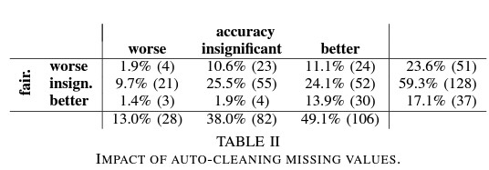
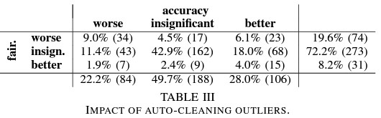
RQ2 Results and Discussion

Slide 12
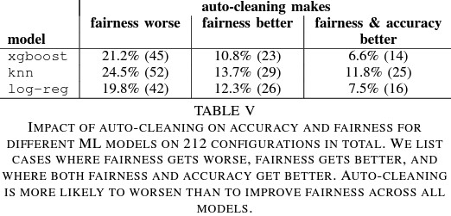
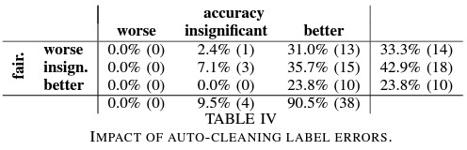
RQ2 Results and Discussion

Slide 13
Conclusion
Conclusion
We will discuss
the implications found in the literature and present summarized results
the future direction of the paper
Contributions (which were discussed in the introduction of the literature)

Slide 14
Discussion
Critiques
The general structure of the paper is a bit redundant because the conclusion is reiterated several times before the conclusion section.
In conjunction, the paper does not present all data before drawing a conclusion. For example, the authors conclude after presenting one table that automated cleaning technique shows a tendency for worsening fairness.
"59.3% of the times it has no significant impact on fairness. Worryingly however, when cleaning does have an impact on fairness, it is more likely to have an adverse impact (23.6%) than a positive one (17.1%)" page 5
The authors decided that the 9.3% difference would be considered "no significant impact" while 6.5% between positive and adverse impacts is considered a significant enough to draw this conclusion. There doesn't seem to be clear criteria for this decision.
The paper also suggests to retire some datasets for being outdated but ultimately does not have the statistical evidence to back the claim.

Slide 15
References

